Slide 1
Climate Change:
Its Causes and
Impacts

Slide 2
Topics to be covered:
What is climate change?
Is climate change real?
What are the causes of climate change?
What are the impacts of climate change?
Climate change in Bangladesh.
What should we do?

Slide 3
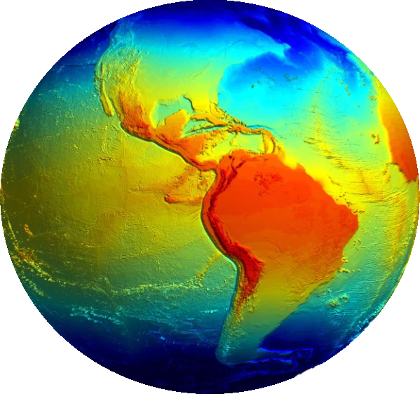
Meaning of climate change:
Climate change is a change in the
Statistical distribution of
weather patterns.

Slide 4
Climate change is REAL
Polar bears are disappearing.
The dark ocean reflects only 6% of
solar radiation.
Sea level rose 8 inch in 119 years.
Sea ice melting.
Temperature is rising significantly.

Slide 5
Observation of climate change:
Observed warming
since the
pre-industrial age.
1 C

Slide 6
Causes of climate change:
Deforestation.
Increasing livestock farming.
Fluorinated gas.
Industrial waste.
Solar irradiance.

Slide 7
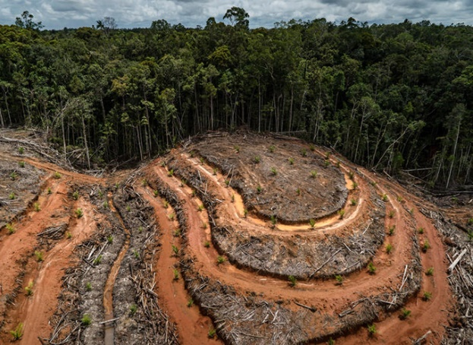
Deforestation

Slide 8
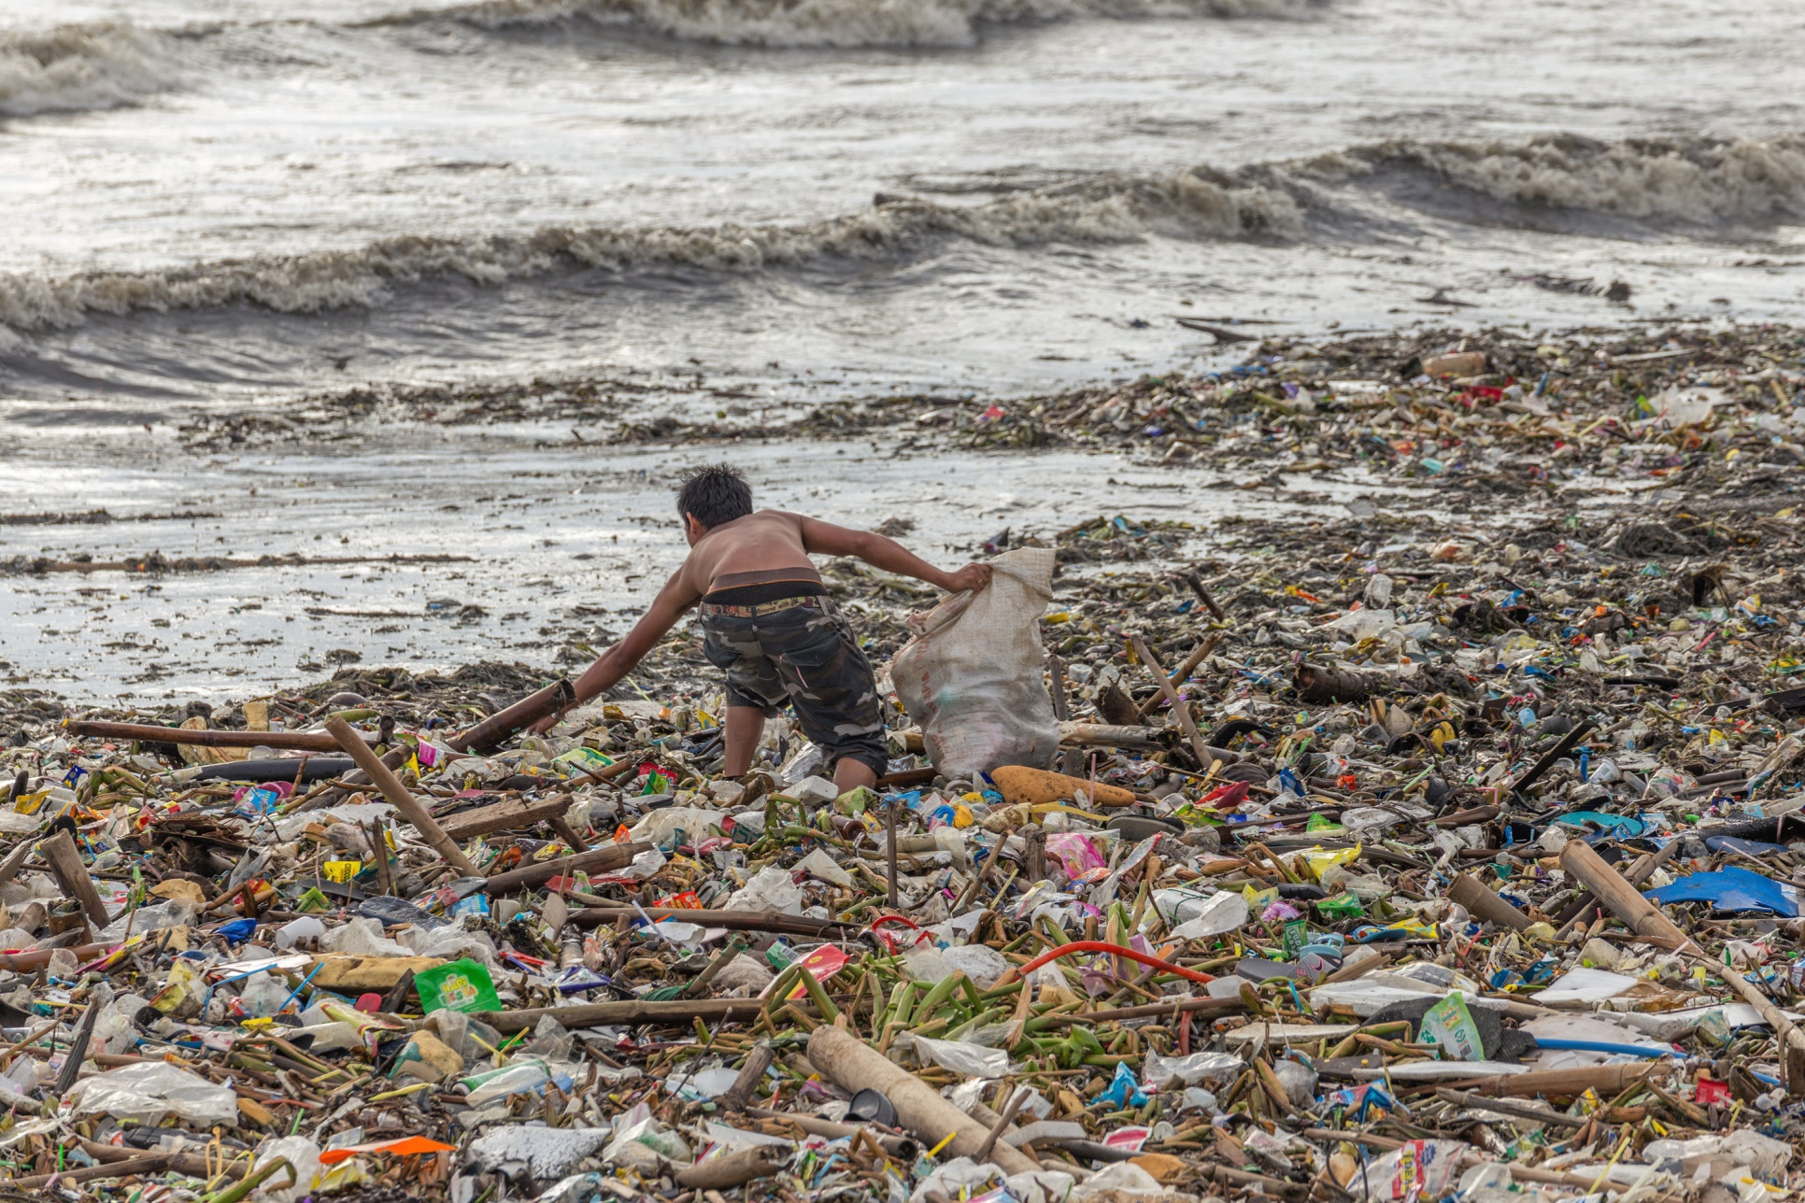
Industrial waste

Slide 9
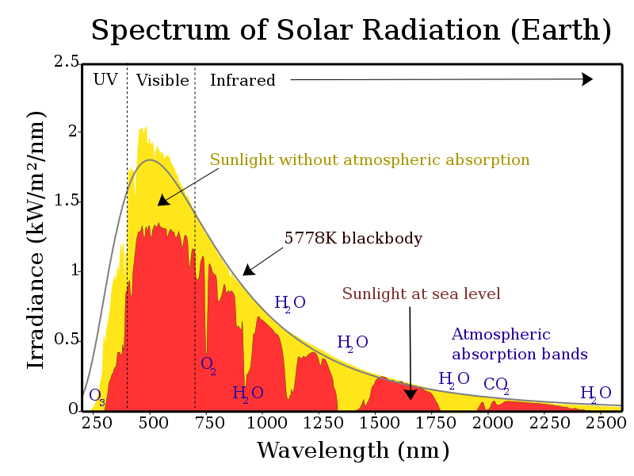
SolarIrradiance

Slide 10
Impacts of climate change:
The threshold of danger.
2 C
1 C

Slide 11
Impact of temperature rise:
4 C
Hell on Earth
2 C
1 C

Slide 12
Impact of temperature rise:
Where we are headed
6 C
4 C
2 C
By 2100, according to the international Energy agency
1 C

Slide 13
Result of climate change:
By 2100:
Highest temps in 30 m years.
Sea level rise of 3-6 feet.
Drought over 40% of inhabited land.
Hundreds of millions of refugees.

Slide 14
Climate change in Bangladesh:
We are experiencing unexpected temps rise.
5000 people were killed in the Cyclone Sidr.
Agriculture could be reduced up to 50% by 2021.
Nations like Bangladesh, Maldives could be
completely wiped off the map in 50 to 60 years.

Slide 15
Soul causes of climate change
in Bangladesh are:
Carbon emission.
Unplanned economic zone.
Trees are getting cut down.
Air pollution.
Water pollution.

Slide 16
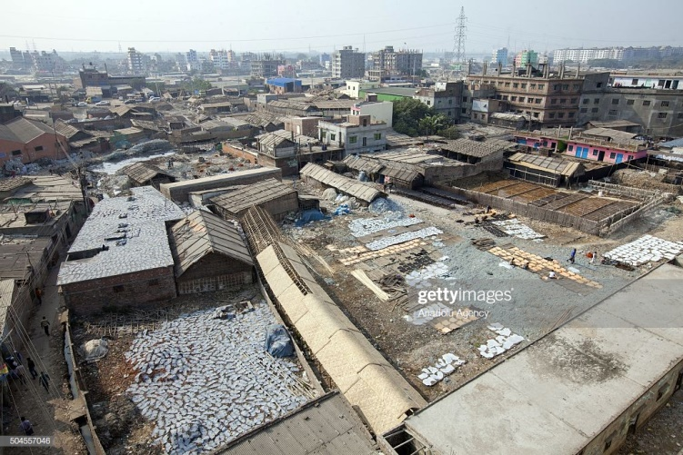
Unplanned economic zone

Slide 17
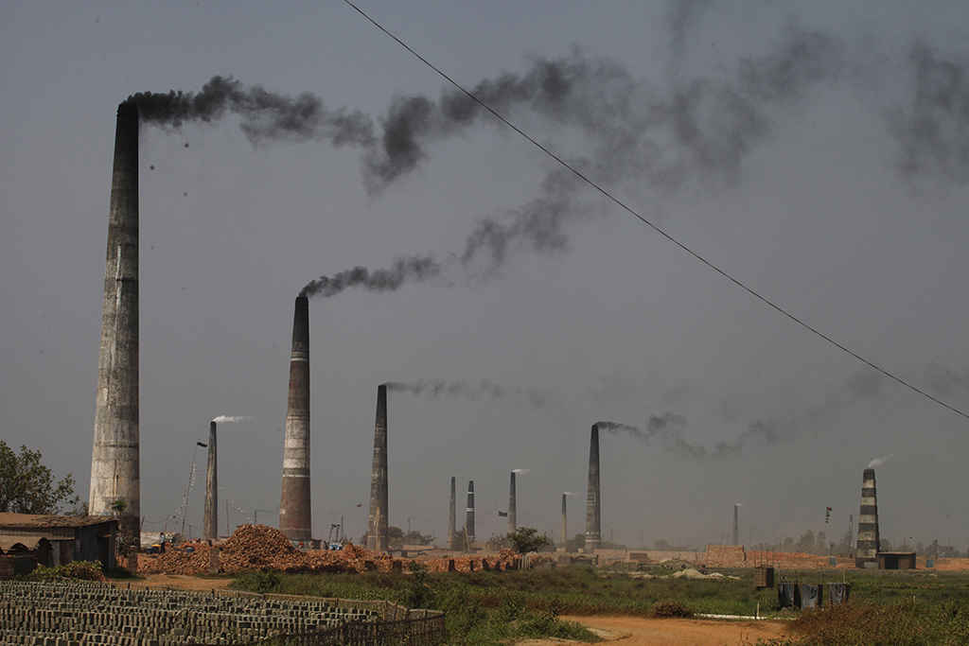
Air pollution in Bangladesh

Slide 18
What we should do:
Better power plants, less coal burning.
Less cars.
Less burning fossil fuels.
Busses and trains instead.

Slide 19
Thank You!

